Slide 1
QA Agent Expand Process by Documented Response
UiPath AgentHack. Build the AI agents of tomorrow.

Slide 2

Siyang​ Team QA Agent: Expand Process by Documented Response ​
Siyang Wu
2025 UiPath Certified Professional Software Testing Engineer Professional Certification
2023 UiPath Community MVP 2023
2023 UiPath Certified Professional Specialized AI Professional Certification
2023 UiPath Certified Professional Automation Business Analyst Professional Certification
2022 UiPath Community MVP 2022
2022 UiPath Certified Professional Advanced RPA Developer (UiARD)
2021 UiPath Community MVP 2021
2020 UiPath Community MVP 2020
Vice President @Ztenith wusiyangjia@163.com

Slide 3
Problem statement and proposed solution
Problem
Solution
Many RPA process stop at a QA step for communication or confirmation, it means many end to end processes have to be split, it makes the opportunities of high-ROI automation reduced.
When implementing an automation solution based on RPA, non-intrusiveness to the application system is possible, but non-intrusiveness to the business process usually cannot be achieved, the transformation always need process transformation and change user's working habits in business workflow for automation, it slows the speed of the automation transformation or prolonged its implementation period.
Building a general QA agent to handle all requests and confirmations in communications of business process, the input, output, tasks and rules of QA agent are all clear, so that QA agent can be easy to correctly processed by LLM and has low maintenance costs.
Usage is the most important thing, and user acceptance is most important thing for increasing usage. All decisions from QA agent are traceable and using QA agent is in line with the working habits before automation, so this solution can be 100% accepted by all people in business process.

Slide 4
Benefits and technologies used
Details
Benefits, impact and outcomes
End-user​ | All participants of the business process that contains confirmation steps
User department​ | Unlimited
Industries​ | Unlimited
UiPath products used​ | UiPath Agent Builder UiPath Studio Web UiPath Orchestrator
Other - integrations / APIs / technologies used​ | None
Almost all existing process can scale the automation scope by using QA agent as a task in UiPath Maestro to realize end-to-end process.
Applying QA agent can be a nonintrusive automation solution for business participants other than users of the automated process. the feature can help automation scope expands to more cross-business cases like RPA's no intrusiveness to application systems.
Since QA sheet originally is an important means of documented confirmation and communication in business work, existed QA sheet can also be seamlessly utilized by the QA agent. QA agent can reduce manual retrieval cost of QA sheet and standardize the way of using QA sheet.

Slide 5
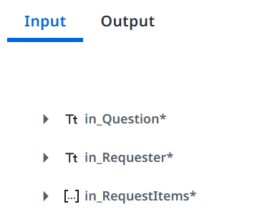
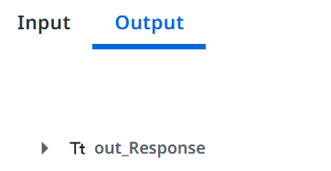
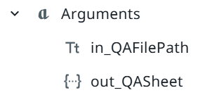
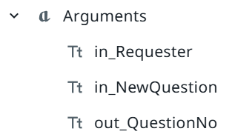
Solution architecture diagram
Y
Y
Answer Empty?
Match All Items?
Y
Output Question Number, etc.
Extract All Values
Read QA Sheet
Match Question?
End
Start
Generate Question
Append
QA Sheet

Slide 6
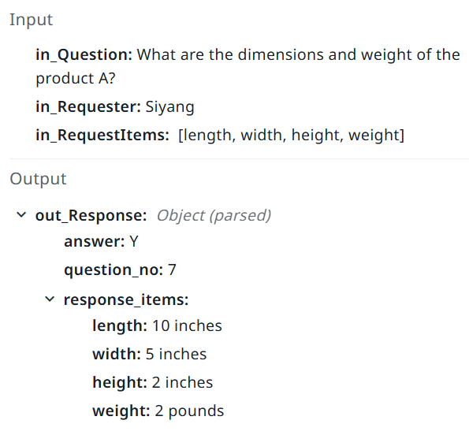
Scenario 1: Multiple Request Items Extraction
1. Get input question and requested output items, use ReadQASheet to get all existed questions, question numbers and answers from column "question", column "No." and column "answer“.
2. Match a question with answer that is not empty based on the input question, extract requested output items from the question's answer and the number of the question, output in json format and end the workflow.
Matched question and the answer in QA sheet:
Question:
"Please provide the dimensions and weight of the A product?"
Answer:
"A product‘s length is 10 inches, width is 5 inches, height is 2 inches and weight is 2 pounds."

Slide 7
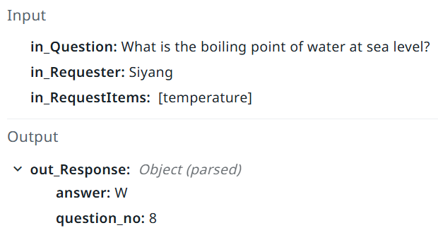
Scenario 2: Matched Question No Answer
1. Get input question and requested output items, use ReadQASheet to get all existed questions, question numbers and answers from column "question", column "No." and column "answer“.
2. If there is a question can be matched, but its answer is empty, then output in json including the number of the question, end workflow.
Matched question and the answer in QA sheet:
Question:
"What is the boiling point of water at sea level? Please provide temperature value."
There is no answer with the question.

Slide 8
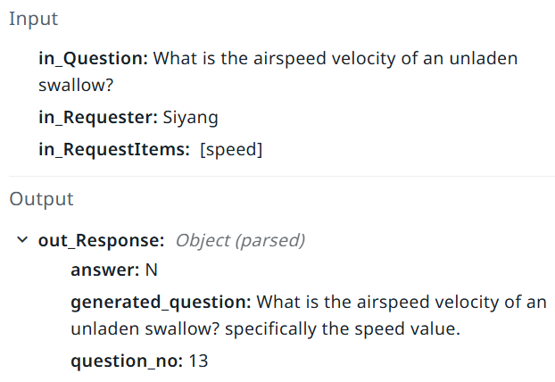
Scenario 3: No Matched Question
1. Get input question and requested output items, use ReadQASheet to get all existed questions, question numbers and answers from column "question", column "No." and column "answer“.
2. If there is no question can be matched with input question, then generate a question naturally combining input question and requested output items, use AppendQASheet by inputting generated question and input requester to append a new question in QA sheet and output in json format including generated question and the question number.
There is no question can be matched with input question in QA sheet.

Slide 9
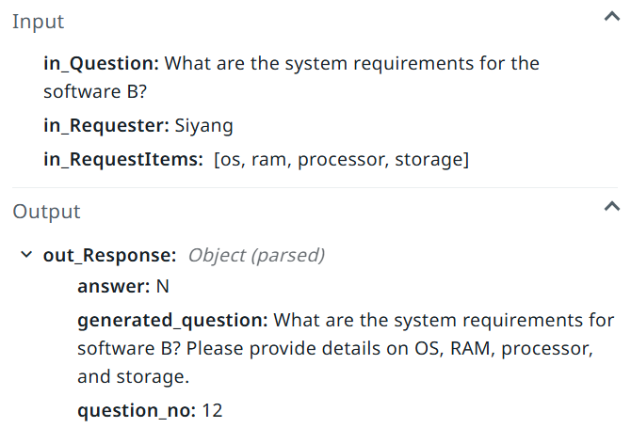
Scenario 4: Matched Question Partial Answer
1. Get input question and requested output items, use ReadQASheet to get all existed questions, question numbers and answers from column "question", column "No." and column "answer“.
2. If matched question's answer cannot be extract all requested output items, then generate a question naturally combining input question and requested output items, use AppendQASheet by inputting generated question and input requester to append a new question in QA sheet and output in json format including generated question and the question number.
Matched question and the answer in QA sheet:
Question:
"What system configuration is required for software B?"
Answer:
"Windows 10 or later, 8 GB ram and Intel i5 or equivalent CPU."

Slide 10
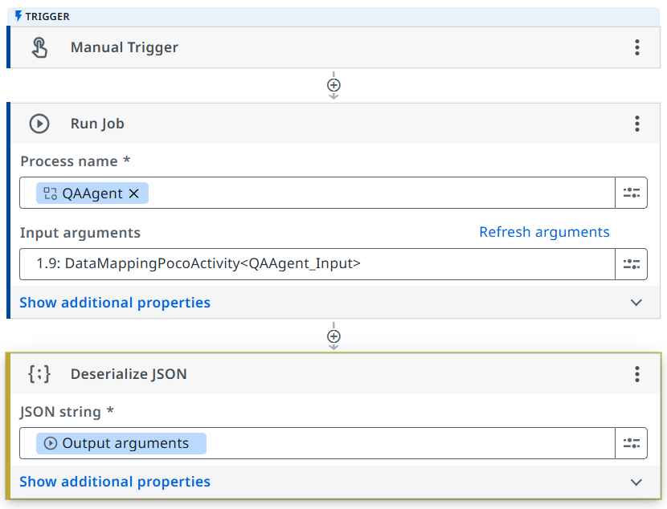
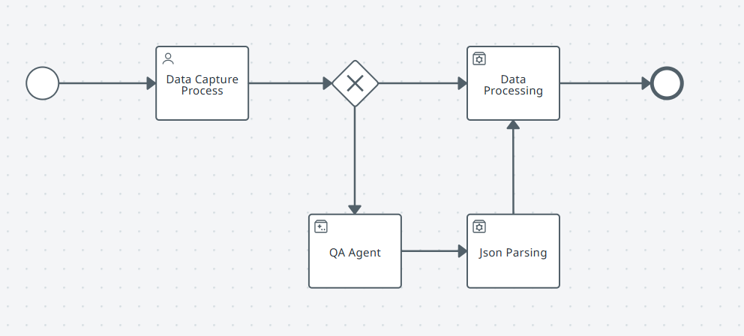
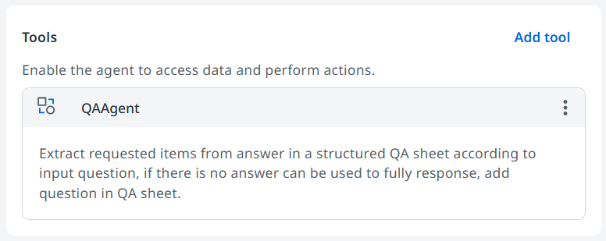
Enhancement and customization for enterprise-level Application
1. Develop tools for reading QA sheet and appending QA in QA sheet for adapting to more archive formats for QA, such as Excel files, shared files, and even OA systems.
2. Design more configuration parameters in agent inputs for adapting to multiple QA sheets retrieval or filtering QA by conditions (date, type, project, etc.) to control the size of the context and increase efficiency.
3. Take existed QA sheet using in workflow as examples to improve the quality of new question generation.
4. Develop application framework for typical application modes. For instance, invoke the agent in an agentic process as a task, in a workflow as an activity, even in another agent as a tool.

Slide 11
When having a question that need answer, use the QA Agent.

